Slide 1
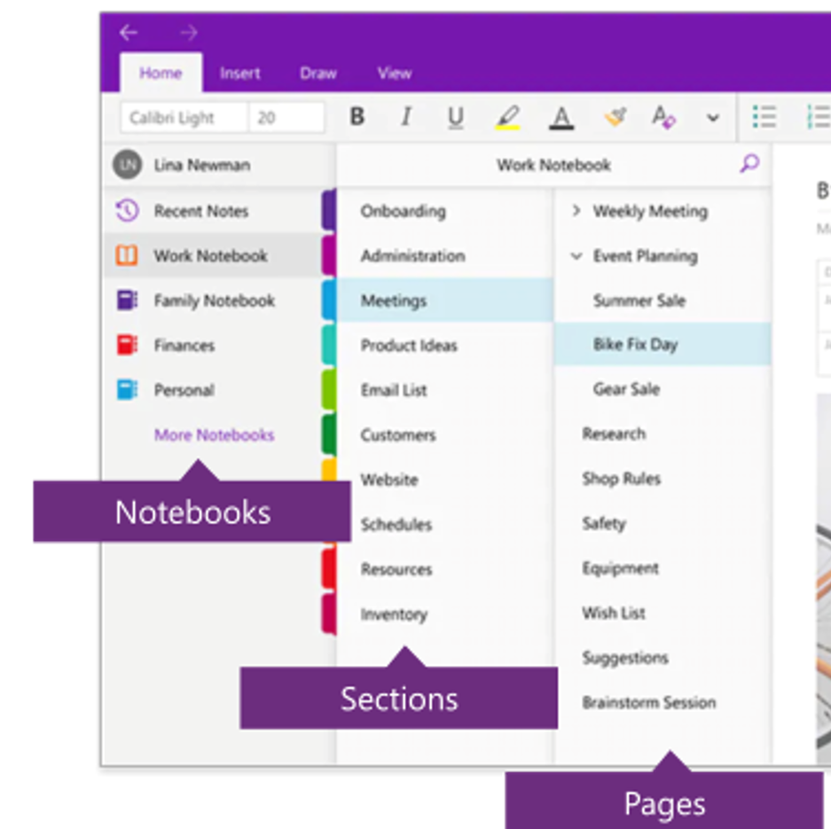
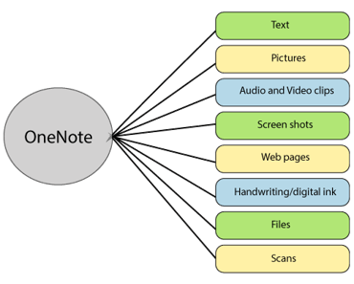
How to create a successful research folder with OneNote
By Makenna Denman

Slide 2
First, create a OneNote Folder in Office365
These are just tips and tricks that were helpful to me during my year in A-level Global, but you are more than welcome to organize the Research Folder to your liking.
I will also show you my Research Folder as an example to guide you.

Slide 3
Second, what should be included in your research folder?
a. All research information and data gathered (ideally with an indication of the date gathered)
b. All quotes, clearly and fully referenced with complete bibliographic information
c. Analysis pages – notes about your thinking on interpreting and analysing what you have read
d. Reflections pages – a kind of ongoing diary where you record your changing thoughts and standpoints towards your topic
Theory and argument pages – where you make note of particular theories that you and other authors have on different aspects of your question
Emerging themes pages – a good research report will be sub-dividing into sections, each looking at different themes or elements of your question. Themes will emerge as you dig deeper into your project and you will need to make a note of all of your thoughts about this
g. Calendar – you could add your timetable to your research folder
h. Keep a record of all references, citations and quotes – do this by hand on paper, manually in Excel or Word, or by using Endnote or Zotero or one of the other academic referencing programs
i. Keep a bibliography from the very start – as above, Endnote or Zotero could manage this for you, but equally you can keep a bibliography manually. The important thing is you need to remember to do this from day one of your project and not miss anything out
OFF TO THE RIGHT, IS EVERYTHING THAT YOU NEED TO HAVE IN YOUR RESEARCH FOLDER. (THIS IS ALSO LOCATED ON DR. CRIHFIELD'S WEBSITE)
ON THE NEXT SLIDE, YOU WILL SEE HOW I ORGANIZED THE TABS LISTED HERE, SO YOU HAVE SOMETHING VISUAL TO GUIDE YOU. THE TAB TITLES ARE IN BOLD and highlighted
Dr. C's website if you do not know it by heart... yet:
https://shshistory.com/a_global.html

Slide 4
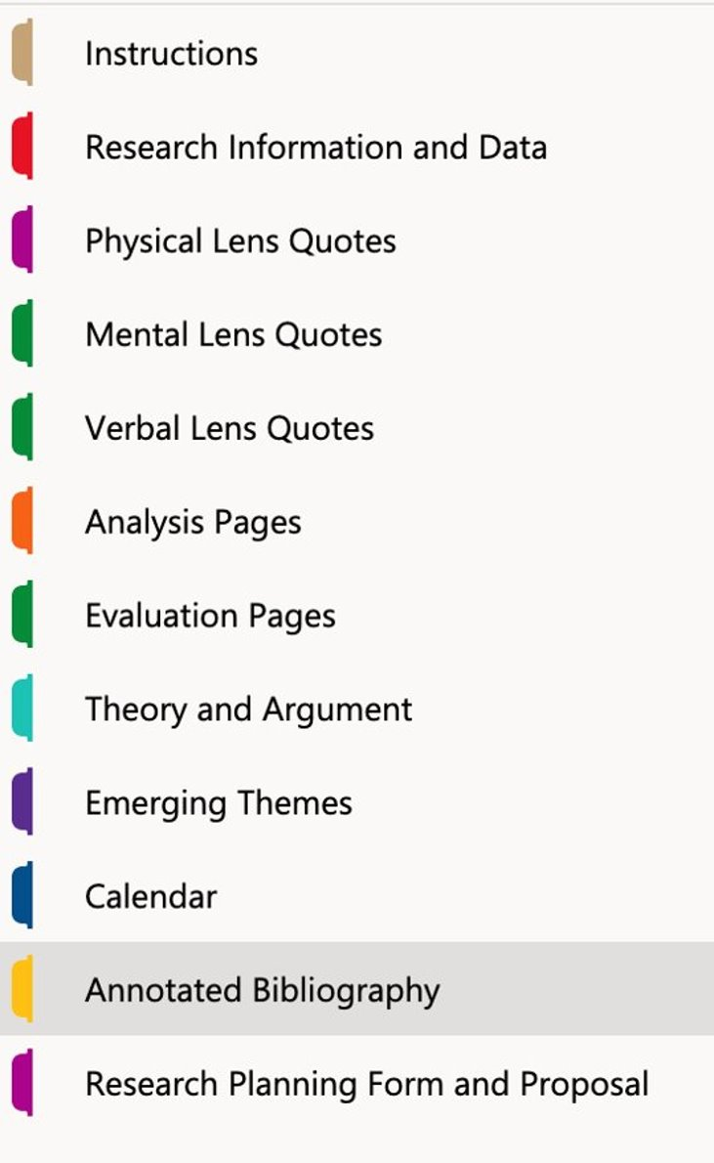
This is what my tabs looked like...
REMEMBER THAT YOUR RESEARCH FOLDER DOES NOT NEED TO LOOK ENTIRELY LIKE mine, BUT IT IS IMPORTANT THAT YOU INCLUDE EVERYTHING THAT WAS MENTIONED IN THE PREVIOUS SLIDE. THIS FOLDER IS MEANT TO HELP AND ORGANIZE YOUR THOUGHTS FOR PAPER 4.

Slide 5
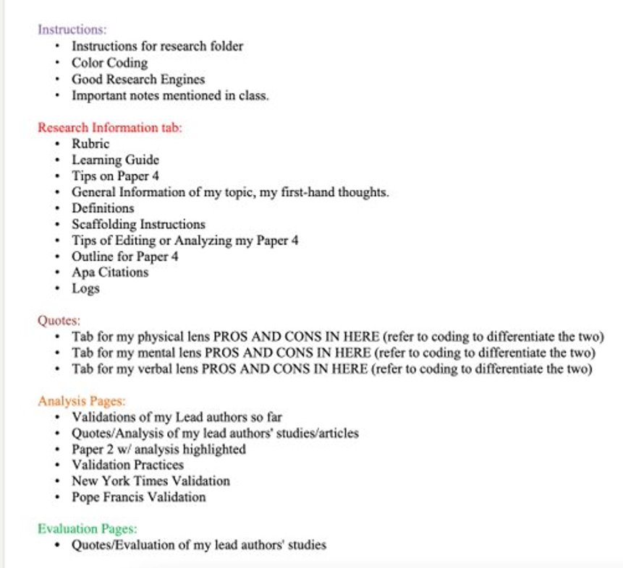
Now, let's dive into each tab. Starting with the instructions section.
YOUR RESEARCH FOLDER IS GOING TO BE RICH OF INFORMATION AND JUST ABOUT EVERYTHING YOU CAN THINK OF. SO, I SUGGEST CREATING A PAGE IN YOUR INSTRUCTIONS section AS A TABLE OF CONTENTS, SO YOU CAN NAVIGATE THROUGH YOUR RESEARCH FOLDER EASILY. In the section, simply press "add page" and title it "table of contents" (This is what you will do whenever you need to add something into your sections 😉) HERE IS WHAT PART OF MINE LOOKS LIKE.
ALSO, ON THIS SAME PAGE, MAYBE CREATE A LITTLE NOTE, FOR OTHERS TO READ SO THEY KNOW HOW YOU HAVE ORGANIZED YOUR FOLDER. THIS IS VERY HELPFUL BECAUSE THROUGHOUT THE YEAR, YOU WILL BE DISCUSSING AND SHARING WITH THE CLASS ABOUT YOUR FOLDER, ESPECIALLY TO DR. CRIHFIELD.

Slide 6
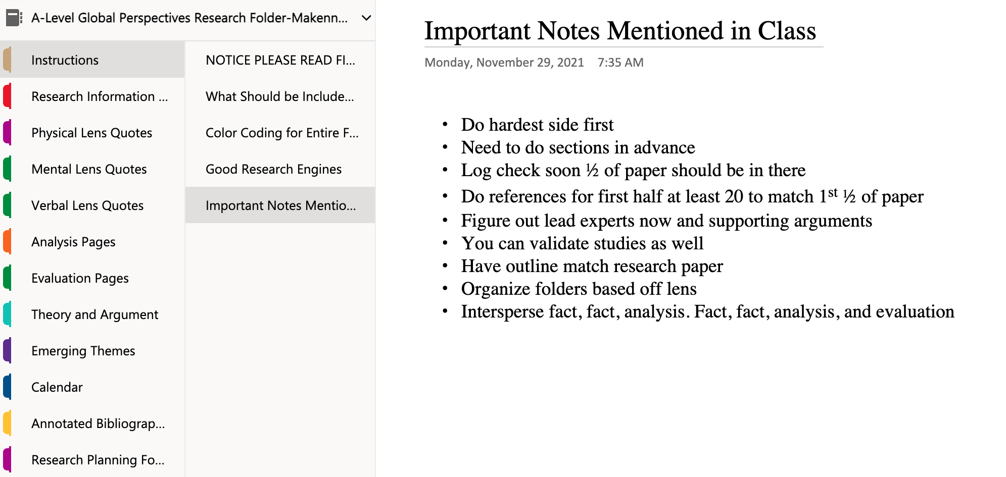
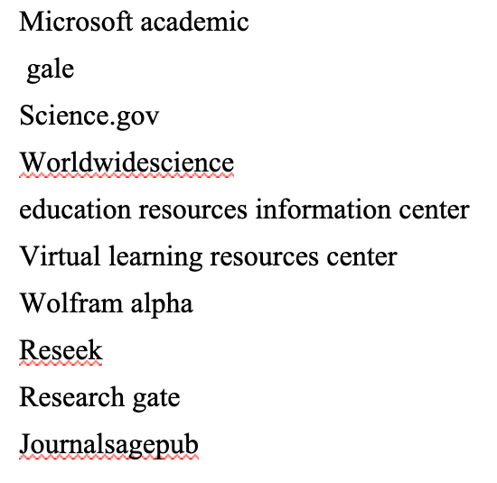
Some suggestions for your "Instructions" section
Now, throughout the year, you will be inputting many things into your folder, so I won't include everything I've put in mine on this PowerPoint. But there are a couple suggestions that I will say throughout this PowerPoint, regarding each section.
Continuing with the "instructions section" I suggest you copy and paste "What should be included in your research folder?" into this section on a new page. (just click back a couple slides and it's there.)
Also in this section, you can create a page dedicated to important things mentioned in class (here is what my instructions section looked like)
You could also create a page that shows what some good research engines are, because you will be doing a LOT of research this year. Here are some, for example that are in my folder. In this section, I would recommend putting anything that you may think will be helpful for you to remember in the future about your paper. Organize it how you want!

Slide 7
Now, let's discuss your Research Information Section
Learning Guide (VERY IMPORTANT; explains the course in depth)
Rubric (also very important)
Tips on Paper 4
APA Citation Notes
Your Logs
HERE IS A LIST OF THINGS THAT YOU WILL BE INCLUDING IN YOUR RESEARCH FOLDER THROUGHOUT THE YEAR. THE THINGS LISTED HERE ARE WHAT I THOUGHT FIT BEST IN THE RESEARCH INFORMATION SECTION. YOU DO NOT HAVE TO INCLUDE THESE NOW, BUT JUST BE AWARE :).
Yet, everything listed here is very helpful towards your paper. It is better to have them in your research folder so you can easily find them in the future and navigate through them with ease.
Majority of these docs will be on Dr. C's website ( not your logs of course.) Yet, there are some other helpful things you could input in here as well, such as your definitions (highly recommend) you will be using in your paper, scaffolding instructions, your outline for Paper 4 and other tips for items such as analysis and evaluation. Majority of the things listed here you will not have to do till later in the year, but it is good to be mindful of them now, so you are prepared!

Slide 8
Here is a little video to help you visualize what your research information section could look like

Slide 9
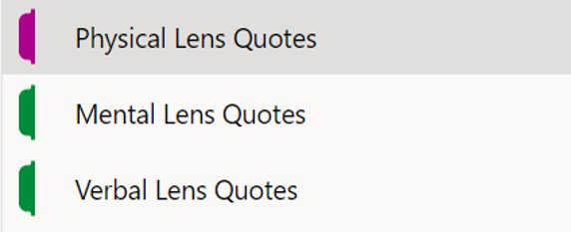
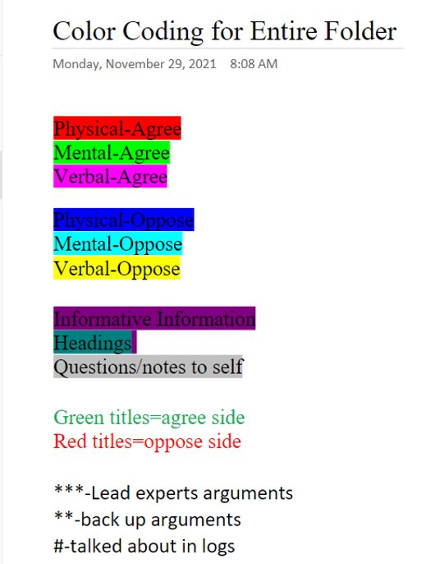
QUOTES SECTION
My lenses
The quotes section will probably be the most helpful for you this year. At least for me, I was able to gather all my concrete research I gathered throughout the year and input those in here. I did it a little differently, but feel free to do it however you want. This is YOUR research folder. It is meant to help you, so don't treat it like another random assignment. I divided up the sections of my quotes based on my lens (look to the right) I also color coded my notes so I can easily navigate through them (Also look to the right) this will help you tremendously, especially when you begin writing your paper. On the next page, I'll show some examples of my research in the quotes section along with a video to show you all my research I conducted and how I added that into my folder.

Slide 10
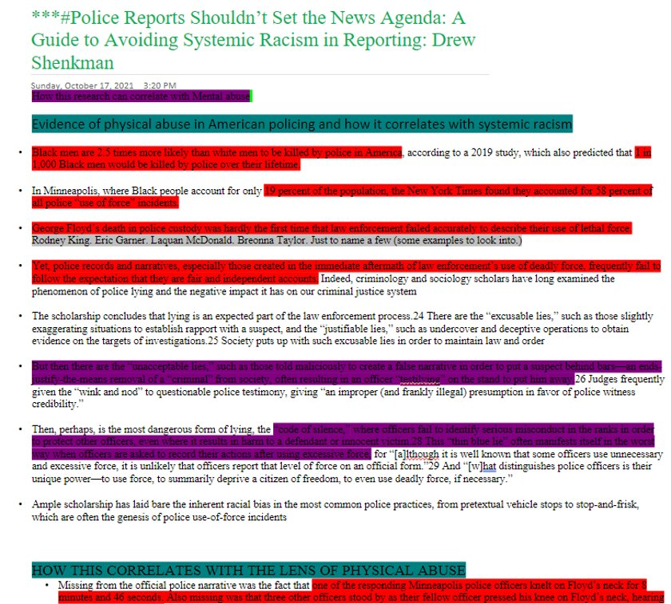
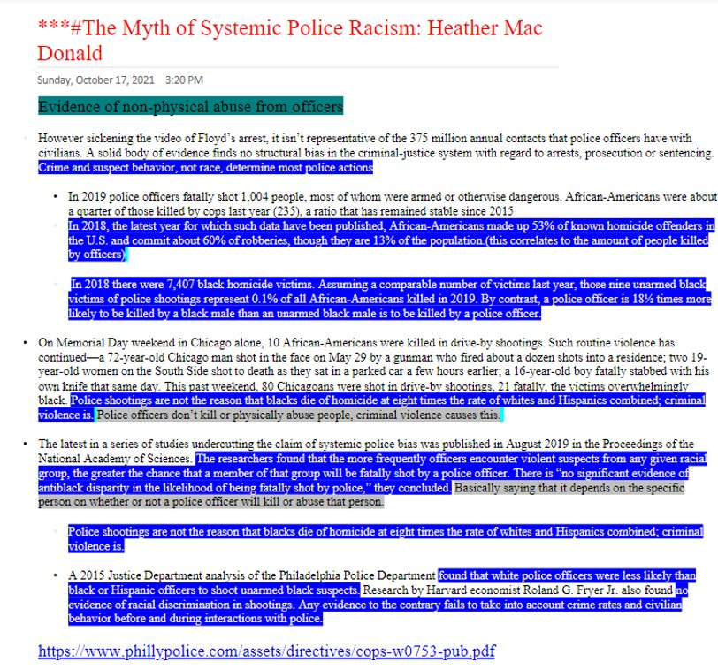
The next couple of slides, I will show you some examples of my quoted material in my folder. My question was, "Is systemic racism present in American policing?" My lenses were, physical abuse, mental abuse, and verbal abuse. These are examples of my opposing and agreeing sides of the physical abuse lens.

Slide 11
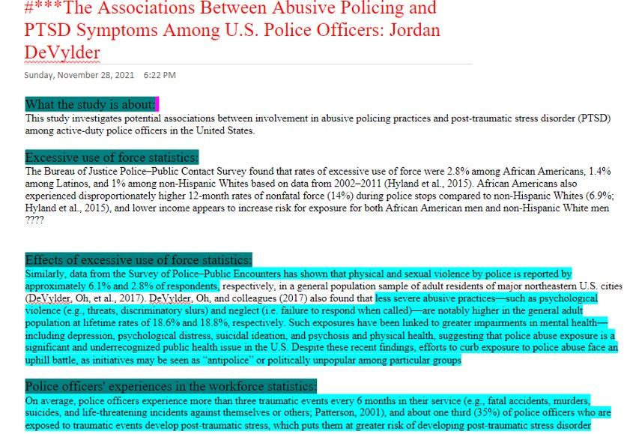
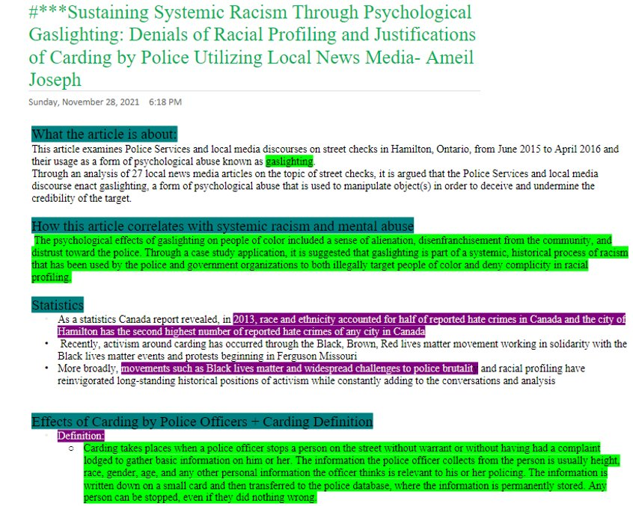
Mental abuse agree/oppose examples

Slide 12
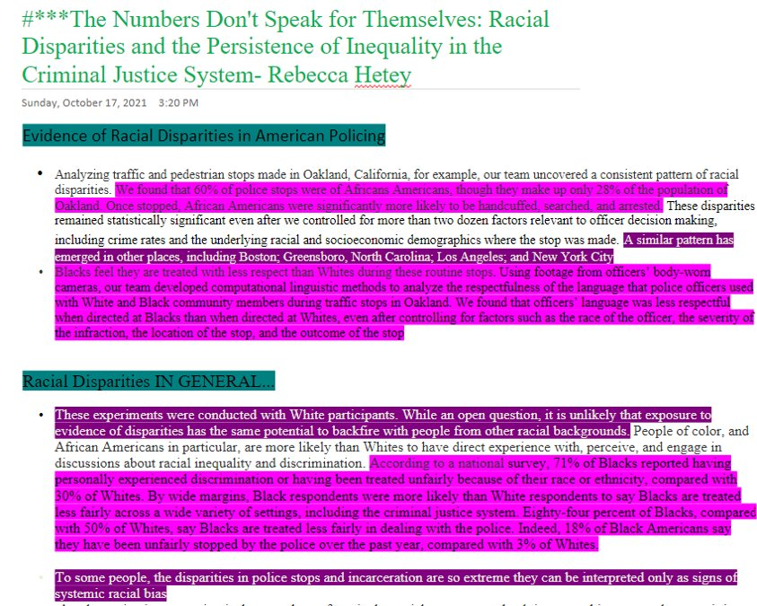
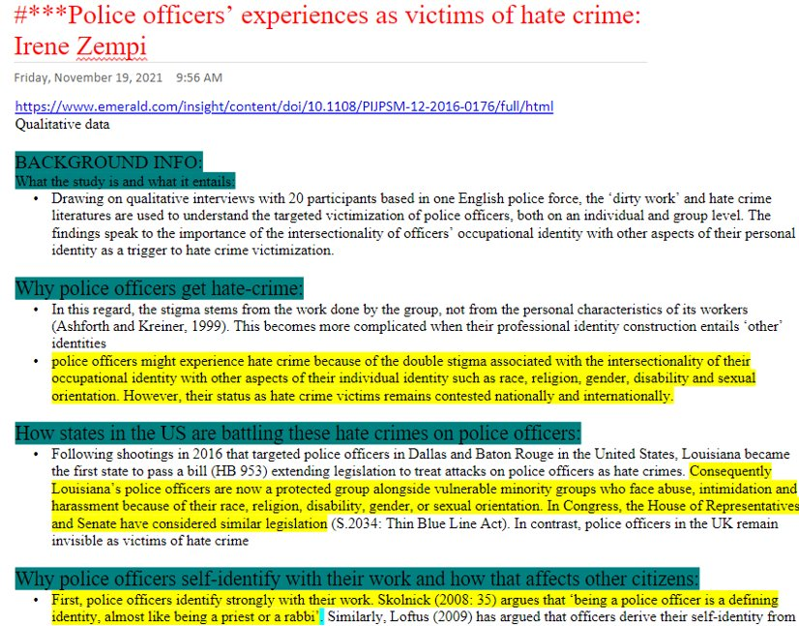
Verbal abuse agree/oppose examples
Keep in mind, that these are just snippets of my quotes, try to research as much as you can! It is better to have a ton of research than barely any at all.

Slide 13
Video for quotes

Slide 14
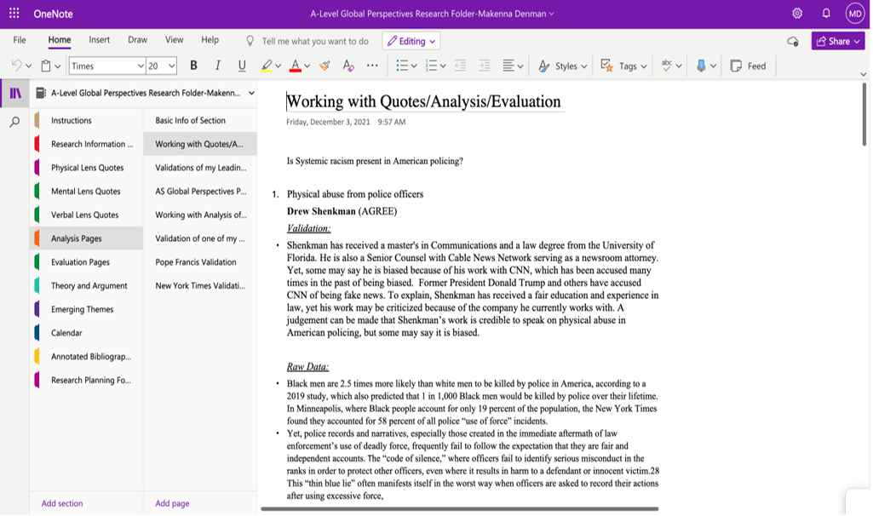
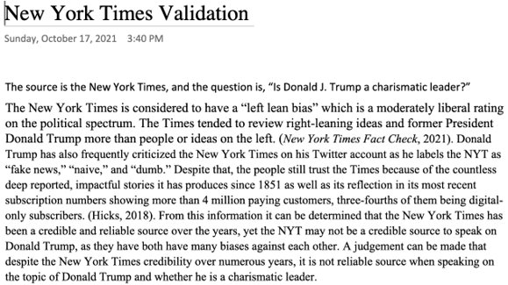
Analysis Pages Section
"Analysis Pages” will be used for exercises and can be used for writing analysis for all your quotes/research. Here, throughout the year you can input any analysis activities that you do throughout the year. That way, you can refer to these if you need help figuring out some analysis pieces for your paper. Below is an example of analysis I did during my year, and also how I structured this section. The way in which you organize this section depends on how you will be structuring your paper, so do not think that this needs to look exactly like mine! The same goes for your "Evaluation Pages" section as well. Personally, I did not add a whole lot to that section, so I won't go into detail with that. But throughout the year, just put documents in there that deal with evaluation. Remember, this folder is meant to solely help you organize everything you do this year in A-level Global!
An example of a piece of analysis we worked with as a class (more specifically, a validation)
What this section looked like completed for the year in my folder. Don’t be intimidated by each section by the way! It is way easier than you think

Slide 15
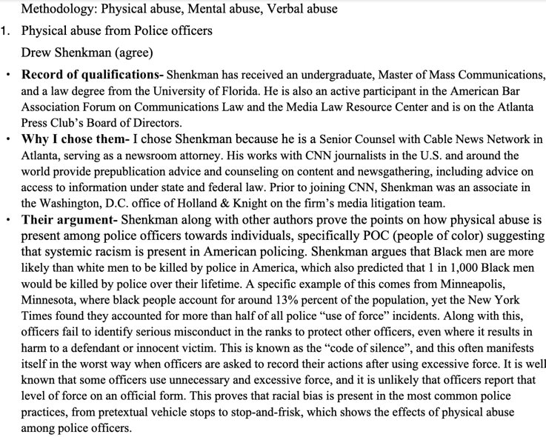
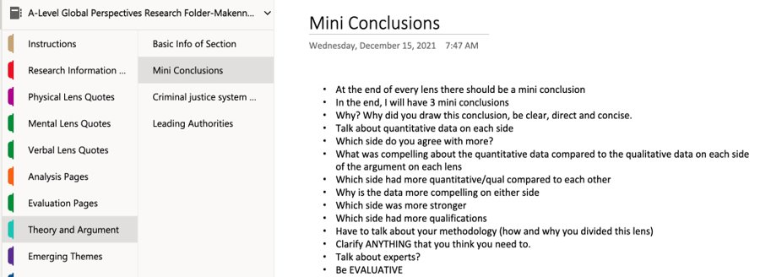
Theory and Argument Section
“Theory/Arguments” is where you can write potential debates relevant to your topic(s) and develop methodologies that could be relevant to your paper. In this section, I mainly included who my lead authorities were in here as well as some tips for your mini conclusions. (if you are reading this presentation in the beginning of the year, trust me you will know what I am talking about in a matter of weeks or months lol.) This page wasn't a big factor in my research folder, but still helpful in organizing my overall product of paper 4! Here are some tips for your mini conclusions I put in my research folder, as well as a sneak peak of what the lead authorities doc looks like.

Slide 16
Emerging Themes Section
A good research report will be sub-dividing into sections, each looking at different themes or elements of your question. Themes will emerge as you dig deeper into your paper, and you will need to make a note of all your thoughts about this
"Emerging Themes” is where you can write your suspected methodology and thesis/concession topics and update it, this section can be helpful if you fall behind on logs since you can see your thought process of the paper.

Slide 17
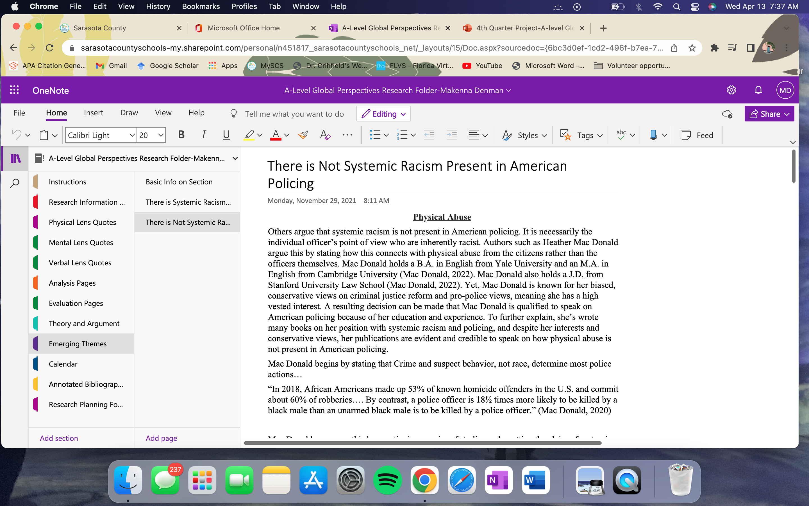
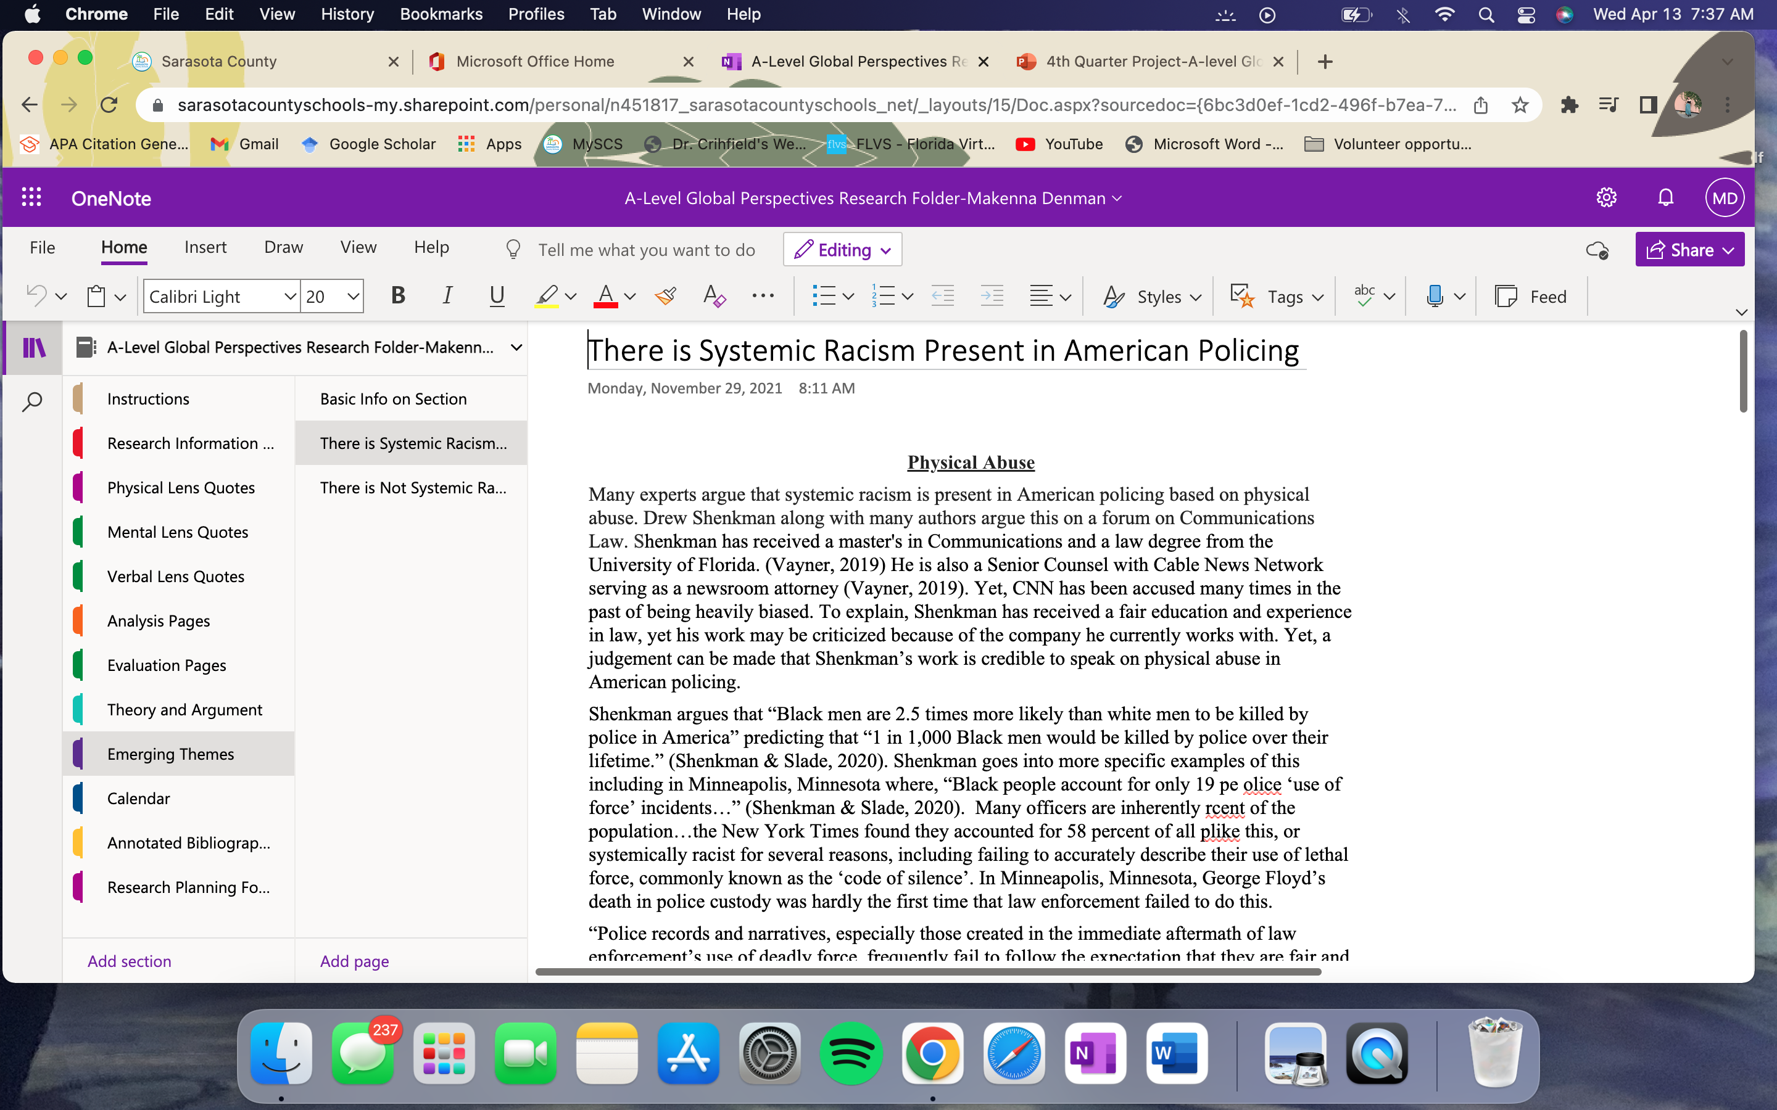
Based off what I said on the last slide, I simply just put agree/oppose sides of my argument on different pages.
Don't feel like you have to include a bunch of information in each section. As long as you have SOMETHING, it will be okay. This is all I put in this section.

Slide 18
Now, let's discuss the calendar.
This is one of the most important sections in your folder, because it is to keep track of everything that you will be doing presently and in the future! Please don't forget to put your calendar into your research folder. This will be handy because you can look ahead at due dates and such and prepare yourself for what is to come.

Slide 19
Here is how I set up my calendar...
Find Dr. C's A-level Global Perspectives Calendar (either on Blackboard or her website).
You will see the calendar pop up, and in the corner of the page you will see a tab that says "Agenda"
Copy everything that is there on that page and paste it into your research folder in the "Calendar Section"
You can delete anything that repeats over a span of a couple days, so you don't take up so much space on this page(I'll show you how I did this for my calendar on the next slide).
You can also add little check-mark boxes next to each event on the calendar. This is very motivating by the way because it shows that you are making progress throughout the year (and if you are a senior, it is somewhat a countdown to your graduation!!)

Slide 20
Video for calendar

Slide 21
The Annotated Bibliography
Another VERY important section in your research folder. “Annotated Bibliography” is where you keep all the citations for all the research/info/quotes that you have. I would recommend annotating the bibliography too so that you know what information you got from each citation. Also, it is helpful to keep it in alphabetical order so that it can be easily copy/pasted into your paper. Each citation needs to be annotated. Follow the instructions on the AS page for form and procedure

Slide 22
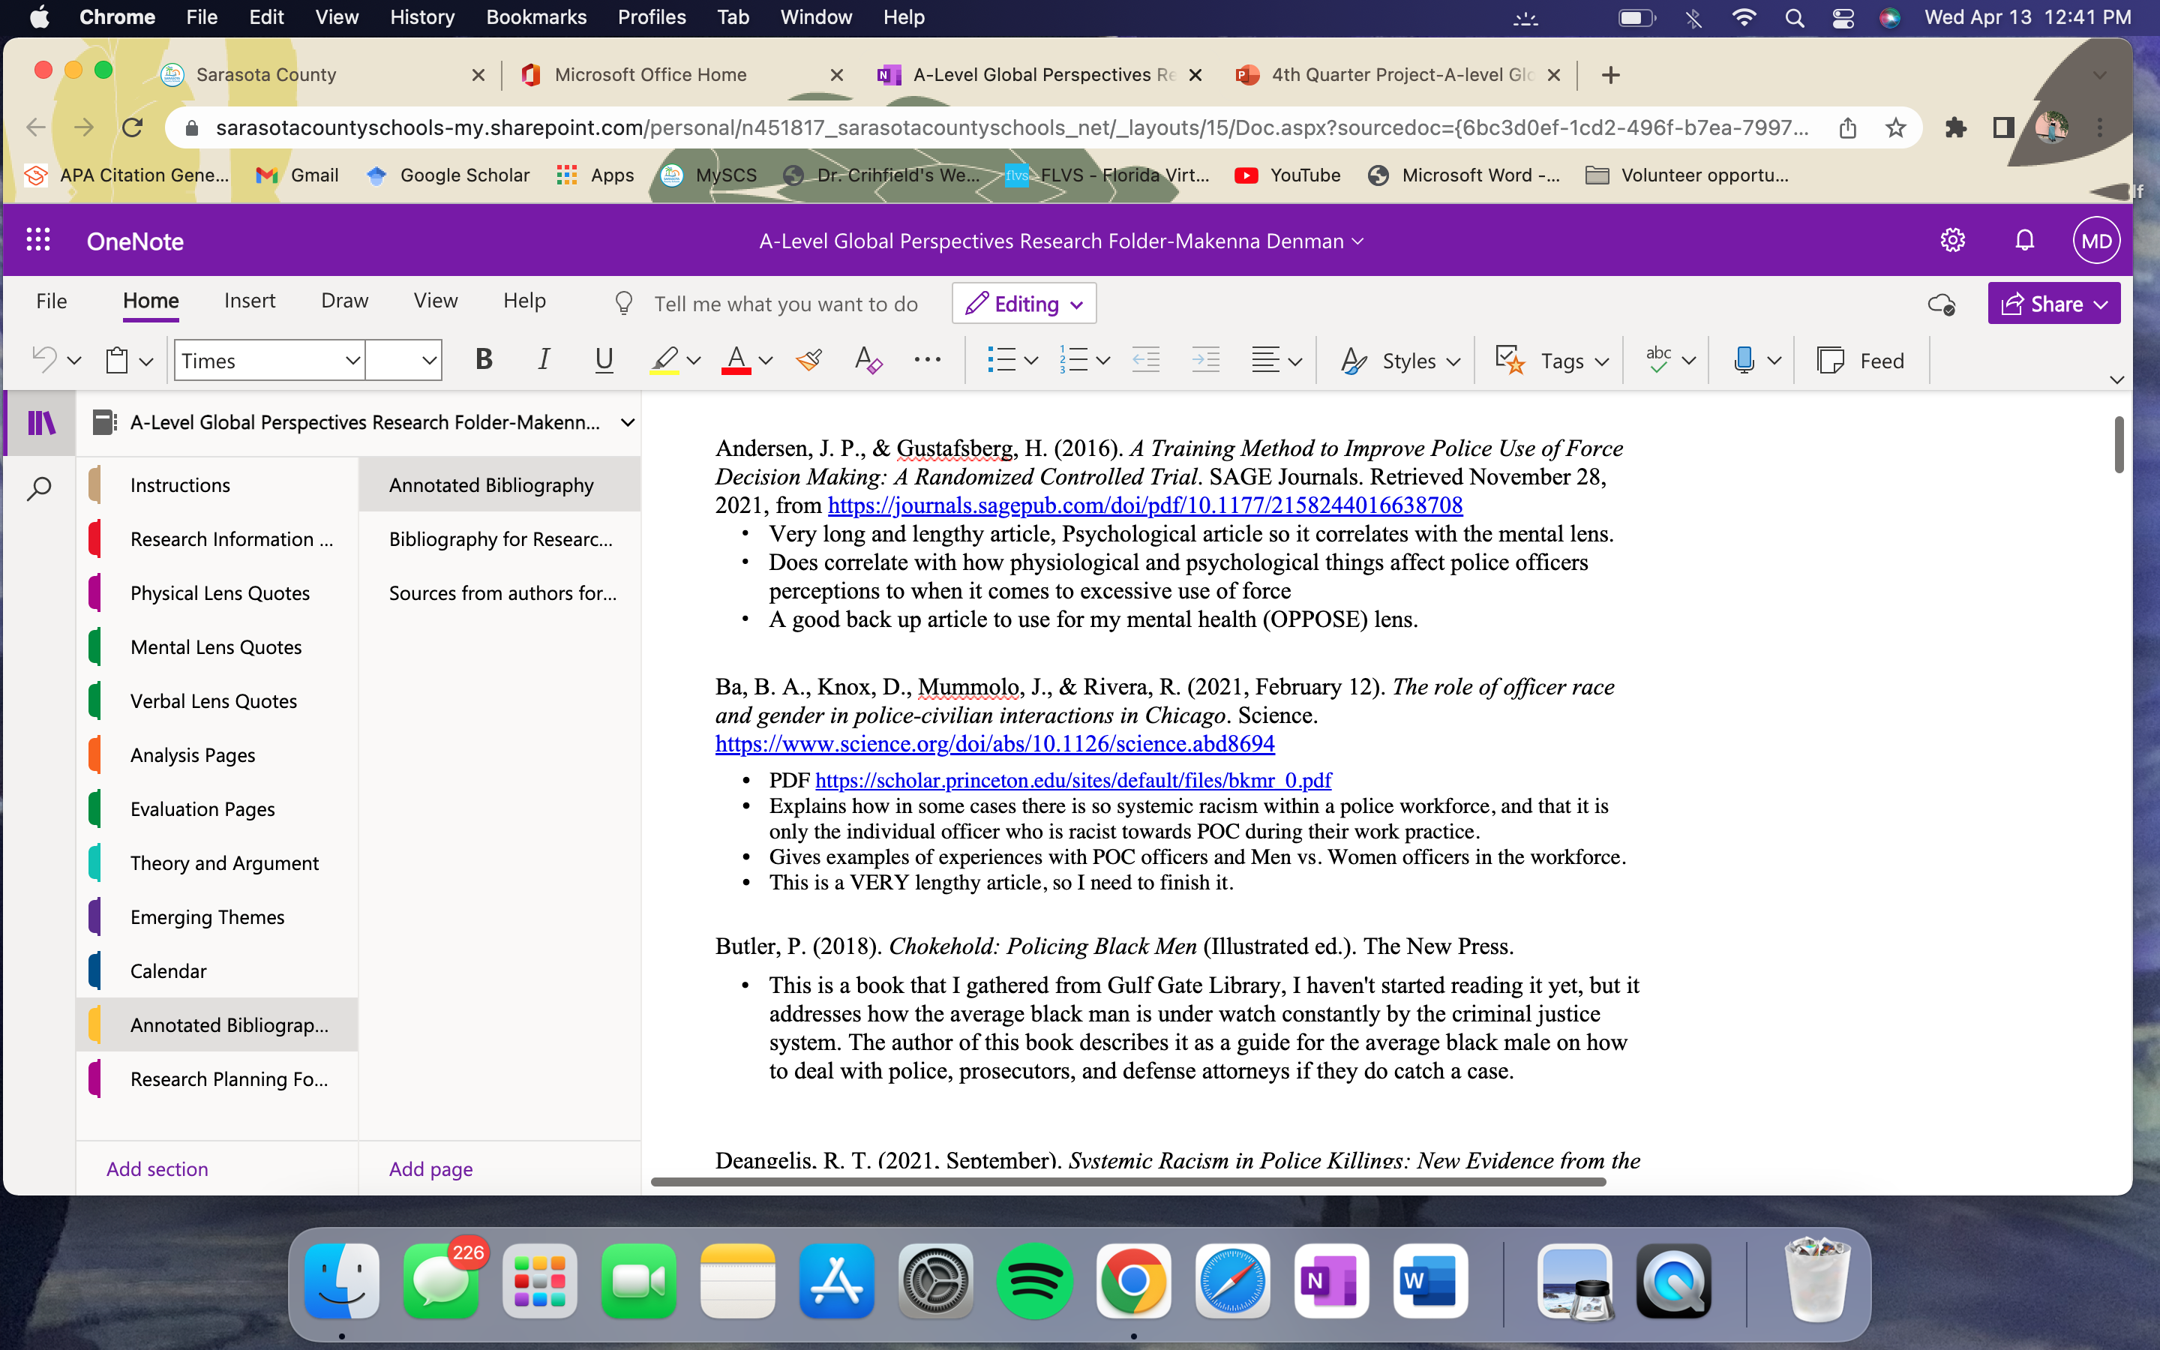
Here are some examples of my annotated bibliography
You need to add to this every single time you come across a piece of research (Seriously! You will regret it if you do not). Simply put what is beneficial from the research and what is not. Once you do this, you can easily decide what needs to be in your paper and what does not.

Slide 23
Some final suggestions and tips for your folder.
I hope this presentation was helpful for you all! Please, don’t be intimidated by the folder! Once you begin the folder, you will get the hang of it, I promise.
Tip #1: Do not wait till the last minute to research. You will greatly regret it and your paper will not be as great as you intend on it being.
Tip #2: Do not wait till the last minute to organize your folder as well. You will have notebook checks through the year. It is not fun trying cram it all in at the last minute. Trust me!
Tip #3: Do not treat this as another assignment. This folder is meant to help you create a successful paper. So do not take advantage of this!

